Slide 1
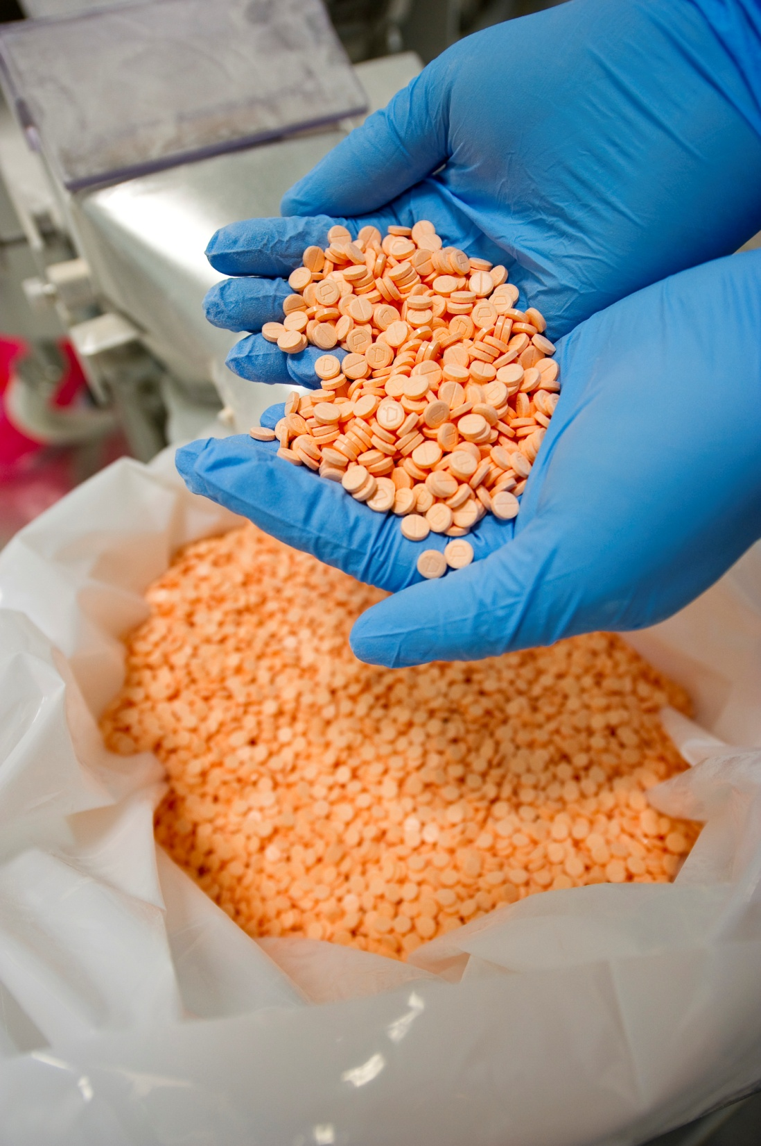
Aspen Investor Visit
Port Elizabeth Site,
South Africa
10 May 2011

Slide 2
Aspen’s Global Footprint
C = Combined sales, marketing, distribution and manufacturing centres
G = Group headquarters
M = Manufacturing centres
S = Sales, marketing and distribution centres
G Durban, South Africa
C Cape Town, South Africa
C Johannesburg, South Africa
M Port Elizabeth, South Africa
M East London, South Africa
M Toluca, Mexico
S Mexico City, Mexico
S Caracas, Venezuela
S Rio de Janeiro, Brazil
M Vittoria, Brazil
S Dublin, Ireland
M Bad Oldesloe, Germany
C Nairobi, Kenya
S Kampala, Uganda
C Dar es Salaam, Tanzania
S Dubai, United Arab Emirates
S Grand Bay, Mauritius
S Quarry Bay, Hong Kong
C Sydney, Australia
M Melbourne, Australia
11
12
18
6
16
7
8
14
13
15
10
3
1
17
9
5
2
4
20
19

Slide 3
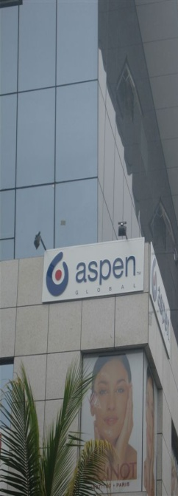
We remain committed to making a meaningful difference in the health of all those using Aspen medicines globally, and to increase our contribution to the lives of people in the many markets we serve across the globe through the manufacture and supply of high-quality, affordable medicines in a responsible manner.
3

Slide 4
Aspen’s Manufacturing Competitive Advantages
Manufacturing capacity and capability is aligned to the Group’s growth strategy
Aspen’s strength lies in its ability to supply high volumes of products reliably with 4.8 billion tablets being manufactured currently
Manufacturing capabilities at the Port Elizabeth and East London facilities have been rationalised
Homogenous product types are produced at designated facilities
Manufacturing capacity in the tabletting can be trebled by 7% increase in the expense base with the addition of only incremental variable costs
Accreditations received from South African and relevant international authorities
Sufficient manufacturing capacity exists to produce required volumes for the domestic and international markets as well to accommodate the introduction of global brands and Sigma products
Focus on economies of scale - international volumes are being transferred to Port Elizabeth to reduce reliance on the public sector volumes
Effective procurement strategies ensure that materials are purchased at competitive prices
There is a committed focus on manufacturing efficiency projects – benefits have already been realised, and initiatives are already in progress to conserve energy and environmental management
Our world class South African Operations team has created Aspen’s
sustainably efficient and competitive manufacturing platform

Slide 5
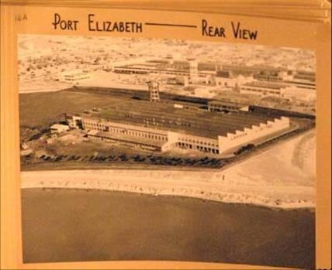
Evolution of Aspen’s Manufacturing Base
Aspen General Facility has been on the present site for approximately 70 years
Acquired by Aspen from South African Druggists in March 1999, together with facilities in East London and Johannesburg
Mainly supplied the South African market
Within 12 years, Aspen has transformed from being a domestically accredited supplier to an international pharmaceutical manufacturer with the developed capability to supply various dosage forms to any pharmaceutical market in the world
In the last 5 years, more than R2 billion has been invested in the Group’s South African facilities for infrastructural expansion and enhancements to improve compliance to the relevant regulatory standards, and in order to support Aspen’s sustained supply to both its domestic and diverse international markets
More than 2700 people are permanently employed at Aspen’s Port Elizabeth, East London and Nutritionals manufacturing facilities

Slide 6
Current Allocation of Domestic and International Volumes
Manufactured products are supplied to Europe, Latin America and China
Additional international volumes are in the process of being introduced to the Port Elizabeth facility
Regulatory approvals are required by the relevant territory, per product, before commercial production can take place

Slide 7
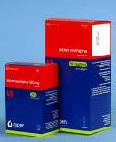
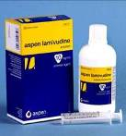
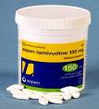
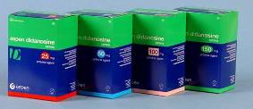
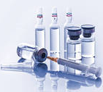
Strategic Manufacturing Partnerships
 | Boehringer Ingelheim | Nevirapine
 | GSK | Lamivudine, Zidovudine, Combivir, Epivir & Others
 | BMS | Stavudine, Didanosine, Atazanavir
 | Gilead | Tenofovir & Emtricitabine
 | MSD | Efavirenz
 | Iroko | Aldomet and Indocid
 | Eli Lilly | Cycloserine and Capreomycin
 | Bayer | Nur- Isterate Injection
 | Prestige Brands | Murine & Murine Plus Range of Eye Drop Products
7

Slide 8
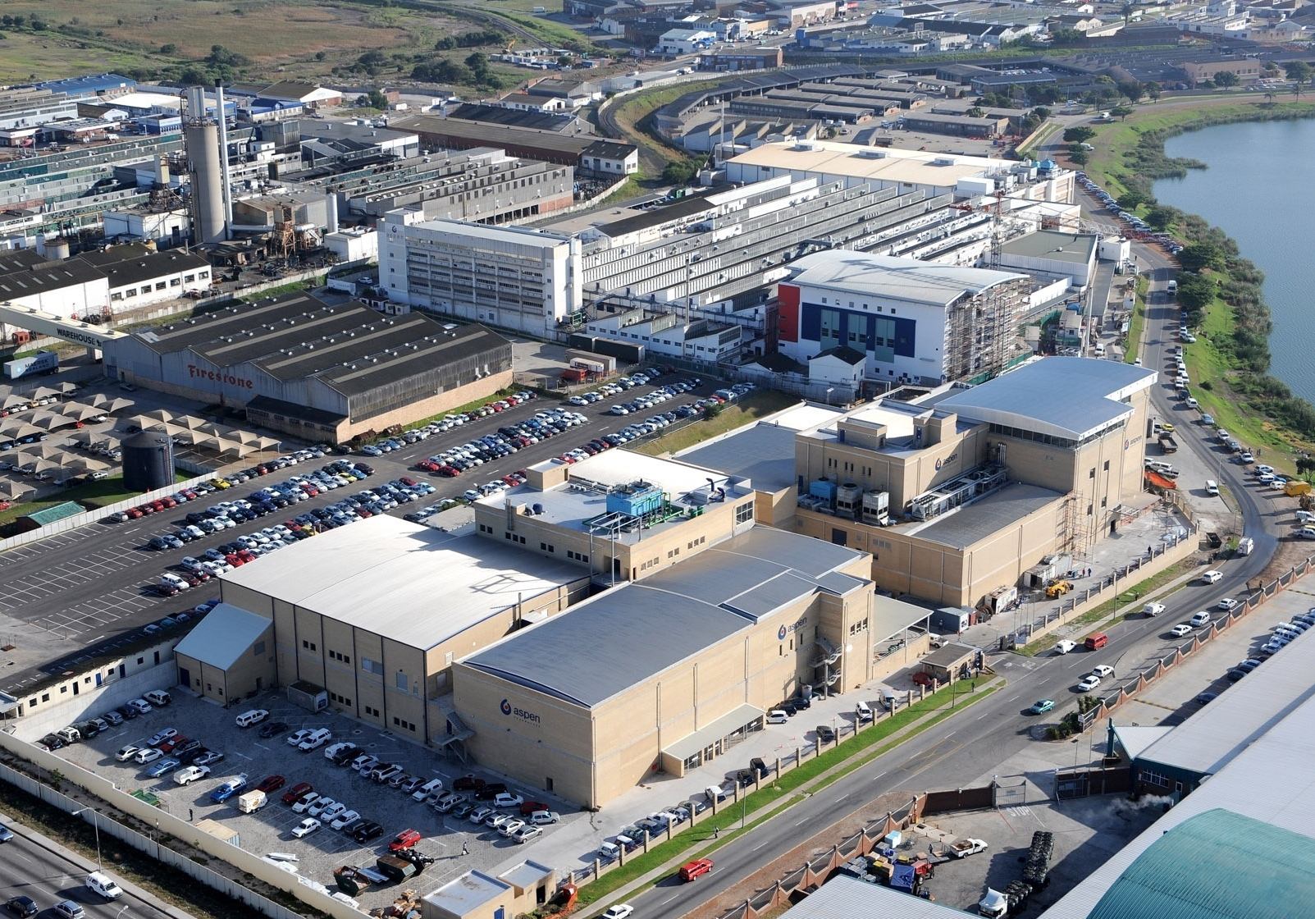
Aerial view of Aspen’s Global Manufacturing Base in Port Elizabeth
Technical Centre
UNIT 3 : General Facility
UNIT 2 : Oral Solids
UNIT 1 : Packing
UNIT 1 : Oral Solids
UNIT 1 : Bottling Plant
Sterile Lyophillisation
&
Eye drop Facility
Sterile Warehouse

Slide 9
Regulatory Authorities Relevant to South African Operations
Regulatory Authority | Unit 1 | Unit 2 | Unit 3 | SVP MP | SVP HP | East London | ADC | ACW
MCC | X | X | X | X | X | X | X | X
FDA | X | # |  | # | # |  | X
MHRA | X | # |  | # | # |  | X
WHO | X | # |  | # | # |  | X
TGA | X | # |  | # | # |  | X
Anvisa (Brazil) | X | # |  | # | # |  | X
 | High volume solid manufacturing for domestic and export markets | Small to medium volume solid manufacturing for domestic and export markets: fluid-bed dried products (2A) & oven dried products (2B) | End state solid packing for domestic market | Eye drops, lyophilized vials for domestic and export markets | High potency (incl. hormonal) injectables for domestic and export markets | Semi-solids, liquids and oral contraceptives for domestic market | Warehousing for domestic and export markets | Warehousing for domestic market
x = Approved
# = Inspection planned

Slide 10
Strategic Rationalisation Initiatives
Significant efficiencies and cost reductions have been realised through the consolidation of the Port Elizabeth site management systems:
Site management and facilities support functions have been consolidated under a single management structure
Historically two separate entities with individual management structures
Significant rationalisation of redundant costs
Consolidation of engineering stores and warehouse management systems
Integrated site stock management systems and hence focussed working capital management
Consolidation of ERP systems for all facilities into a single Baan system
Provides access to a single reporting platform
Facilitates focussed review, analysis and stratification of site information
Assists with effective optimisation of resources and capability
Consolidation of the purchasing systems
Reduced number of purchase orders
Lower average purchase price per order due to combined volumes
Reduced number of lab tests required on incoming materials due to purchase order rationalisation

Slide 11
Unit 1 – Oral Solid Dosage Facility
In 2005, an investment was made in the construction of an FDA-approved facility in response to the HIV/AIDS pandemic in Africa
High volume production of tablets and capsules
The facility was successfully re-inspected by FDA, MRHA and WHO in 2010
No major findings reported
Unit 1 currently manufactures 2.8 billion tablets
A granulation capacity expansion project to the value of R178 million is nearing completion (first suite in operation, with second and third suites in final stages)
This will more double current granulation capacity to increase tabletting capacity

Slide 12
Unit 2 – Oral Solid Dosage Facility
Unit 2
2.0 billion tablets are manufactured in this area
Total capacity = 3 billion tablets
Part 2A – Fluid Bed Dried (FBD) products
Small to medium volume solids production for selected regulated markets
Reformulated products and investment in new equipment
Improved process flow and hence more efficient manufacturing process
Increased automation and improved yields
Reduction in conversion costs
96 tabletted products have been transferred into Unit 2A; 40 products will be transferred by July 2011
Part 2B – Oven dried products
Small volume solids production for selected regulated markets
Investment in new equipment
Increased automation and improved yields
6 products have been transferred into Unit 2B
61 products remain to be transferred by April 2012

Slide 13
Unit 3 – General Facility
A phased process for the transfer of products to Unit 1 and Unit 2 is in progress
Bulk tablet manufacturing at Unit 3 will be decommissioned by end June 2011
Semi-solids (creams, ointments and suppositories) and Liquid Lennon Dutch Medicines have been transferred to East London
Packing for the local market remains in this area

Slide 14
Flow Diagram of the Tabletting Processes
Air
Dispensing
Fluidised Bed Dryer
Scale
Sieving
Granulation
Air
Magnesium Stearate
Blending
Sieving
Compression
Packaging
Coating / Capsule fill

Slide 15
Focus on Continuous Improvement Initiatives
Introduction of the Fluid Bed Drying Process
The older oven drying technology
Wet granule obtained during tablet manufacture is dried by spreading materials onto trays inside an oven
Process time is relatively long, requiring an average of 8 - 16 hour drying time
The newer FBD technology
Wet granule obtained during tablet manufacture is sieved into a drying chamber and hot air is passed through the chamber at relatively high speeds, resulting in fluidisation of the granule
Faster process, requiring 2 - 3 hour drying time
All key and high volume products have been reformulated and are now manufactured in this area
Impact: The benefits of this technology have been extracted and improvements in manufacturing and cost efficiencies have been realised

Slide 16
Focus on Continuous Improvement Initiatives
Doubling of batch sizes to reduce set-up time between batches and thereby optimise equipment utilisation
All Unit 1 manufactured and all Unit 1/3 packed products completed
Unit 2 manufactured products in progress
Impact: Reduction of total annual set up time by 50%
Automation of end-of-line packing to match the increased rate of manufactured output / manual packing processes transferred to automated equipment
Blister and bottle packing completed, and patient ready packing nearing completion
Further projects targeted
Impact: 30% Output improvement in patient-ready packs with a reduction in temporary staff
Modification of batch manufacturing records to improve process documentation flow and move to Electronic Batch Documentation has been initiated
Impact: Expected reduction in administration time and headcount
Barcode inventory management system introduced in warehousing and now being rolled out to production management
Impact: 16% Reduction in headcount achieved to date

Slide 17
Focus on Continuous Improvement Initiatives
Barcode status labelling of materials implemented to reduce handling activities
Impact: More efficient process through an instantaneous scanning process. Reduction in labelling time - manual capturing and labelling change used take up to one shift
Evaluation of shared packing tooling in progress
Impact: Will reduce set-up and changeover time significantly to unlock additional capacity
Re-evaluation of automated (new IBC wash-station) and manual cleaning activities (additional wash-bays at place-of-work and transfer trolleys) in progress
Impact: Will reduce cleaning times to unlock additional capacity
Evaluation of compression set-up and run-rate parameters proceeding well
Impact: Increases in run rates of 20% achieved in Unit 1

Slide 18
In-house Manufacturing Cost Analysis

Slide 19
Impact of Continuous Improvement on Recoveries
Unit 1 Recoveries
+39%
+78%
+120%

Slide 20
Prospects in Solids Manufacturing at the Port Elizabeth Site
The redundant areas in Unit 3 will be converted into specialised manufacturing areas including
High potency suite (HPS)
Toxic suite (TS)
Following approval of the final design, construction of the HPS and TS will commence in the 2012 year
High potency and toxic products both require contained manufacturing areas with the air handling and employee health, safety and protective clothing requirements being more stringent in a toxic manufacturing area
Approximately 4 billion tablets will be transferred into Unit 1, 2, HPS and TS including
Selected global brands from Europe
Selected products from Sigma
Transfer of these products to Port Elizabeth will almost double manufactured volumes to 8.8 billion tablets (currently 4.8 billion tablets are produced in Unit 1 and 2)
Economies of scale will be further improved
The additional volumes will be added with only 50% of incremental variable costs being added. The fixed cost base will remain unchanged

Slide 21
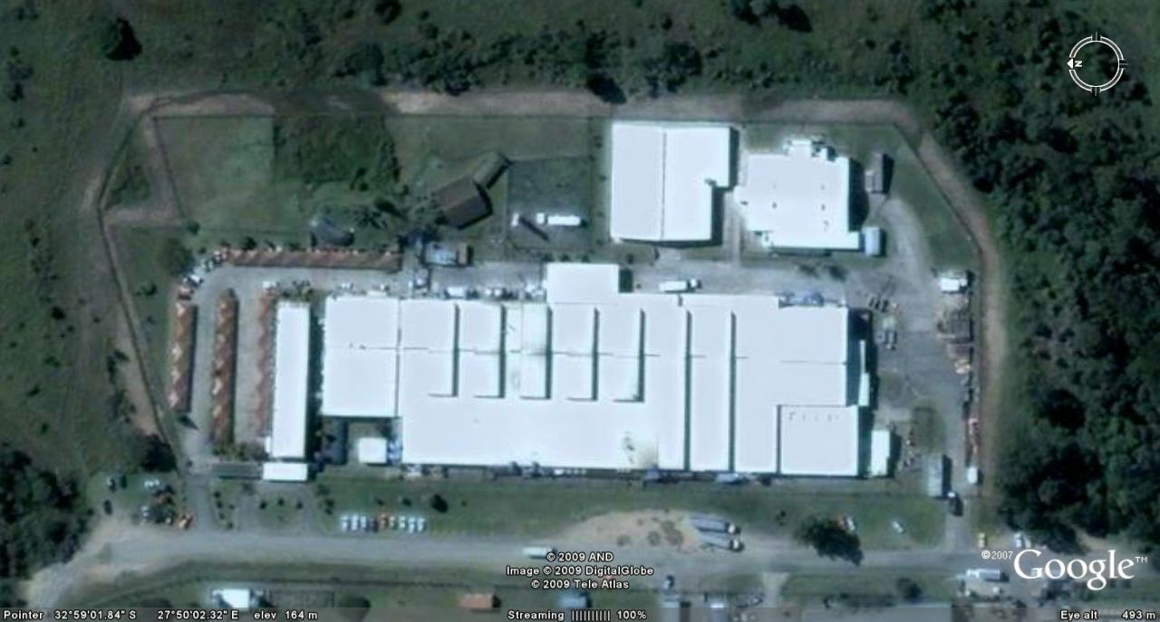
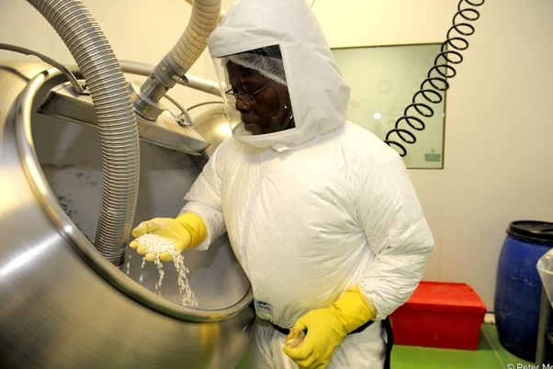
East London Site
API Store
Oral Contraceptives
General Manufacture
Aerial view of East London plant
An employee in the Oral Contraceptives facility
wearing the necessary protective clothing

Slide 22
East London Multi-Purpose Site
General Facility
Highly flexible, small volume, niche, solids manufacture, including low dose drugs
Significant investment has been made into upgrading the East London facility for the manufacture of semi-solids and Dutch medicines
Oral Contraceptive Facility
The Oral Contraceptive Facility provides a contained manufacturing area for the production of high volume oral contraceptives for the public and private sector

Slide 23
The Steriles Facility
Project commenced in 2007, presenting challenging complexities of design, technology, technical compliance requirements and specialist skills
Specialist facility for the manufacture of eye drops, lyophilised vials and sterile injectables, including hormonal vials and ampoules (a niche capability to supply female contraceptives and HRT products)
The facility commenced with the production of eye drops for the US market in July 2009
The lyophilised vials area was commercialised in September 2010
Approved by the MCC for the manufacture of sterile eye drops and lyophilised vials, with WHO approval for Capreomycin being targeted
Export certificates were granted by the FDA and MCC for the supply of eye drops into the USA
The sterile facility represents a niche and complex manufacturing

Slide 24
Steriles Facility – Multi-Product Suite
Lines 1 and 2
High volume eye drops with an annual capacity of 42 million units
Close to 30 million units being exported to US and Canada under a manufacturing contract with Prestige Brands
Aspen’s Eye Gene range has been introduced; remaining Aspen range of eye drops, i.e. Safyr Bleu and Oculerge in progress
Line 3
Lypophilised vials have been introduced into this area, starting with Capreomycin, a product for MDR TB
Vancomycin, Clarithromycin and other lyophilised products will be introduced in 2011
Capacity for lyophilised vials is approximately 2.4 million units
Additional capacity exists for 2.9 million liquid filled vials
Vitamin B Co, Vitamin B12 and Thiamine liquid filled vials are currently being introduced
Additional space exists to cater for the introduction of further capabilities - an engineering and design feasibility study has been completed

Slide 25
Steriles Facility – High Potency Suite
Line 4
High volume ampoule filling capability for hormonal injectables - a niche capability for filling and packing oily solutions which is very relevant to emerging markets
Validation batches of Bayer Nur-Isterate are scheduled for 2011
Aspen’s Lenasone, Betanoid and Decasone are currently being introduced. The MCC have been invited to inspect and approve this area of the facility, where after full commercial production will commence
Annual capacity for 30 million ampoules
Line 5
High volume vial filling capability for hormonal injectables - a unique aseptic suspension filling capability
Aspen’s Medroxyprogesterone is envisaged to be manufactured for SA, emerging markets and WHO territories; a global formulation is being developed for world wide supply
Offtake initially forecast at 20 million vials, annual capacity for vial filling of approximately 45 million units
Application has recently been made to MCC for inspection of this area in order to facilitate commercial production

Slide 26
Procurement Initiatives
Comprehensive understanding of products / materials, driving factors and market factors
Ability to effectively benchmark product prices, quality and supplier service to ensure that we are procuring optimally
Longstanding relationships have been established with international API and packaging suppliers
Ability to source competitively from developing markets
Only reputed and validated suppliers are approved for use
Alternate suppliers are in place to mitigate supply risk and leverage pricing

Slide 27
Allocation of Procurement Currencies
Most API’s and excipients are purchased mainly from Asia:
India
China
Packaging materials are largely purchased from South African suppliers
Aspen received an A-rating from Empowerdex in the preferential procurement category

Slide 28
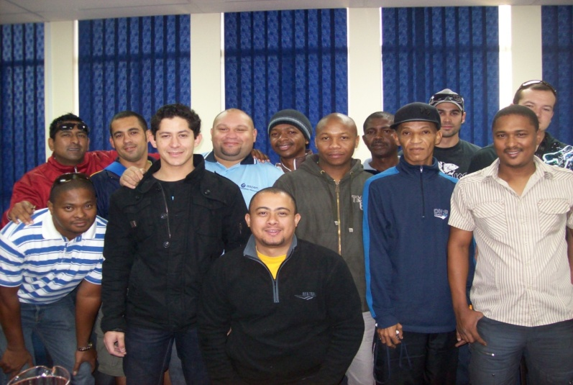
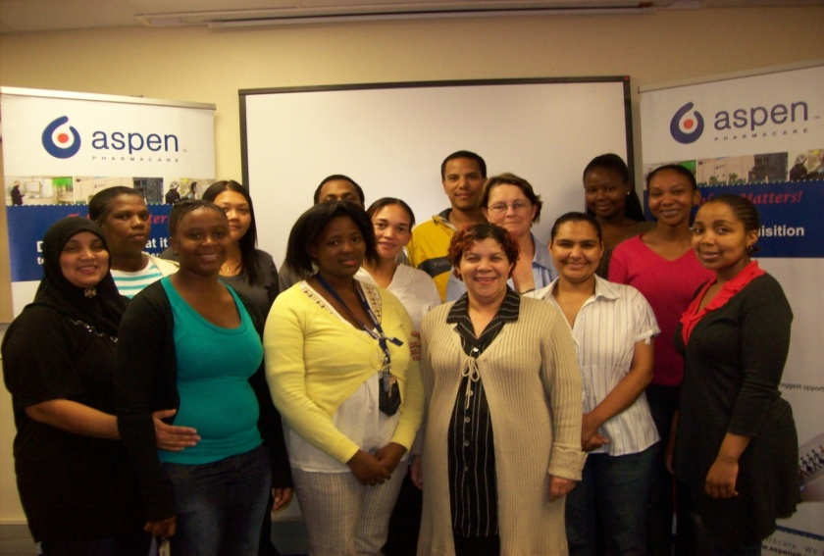
Training and Development
140 new/ongoing 2010/11 Learnerships are in place, covering the fields of Business Administration, Equipment Setting and Operation, Safety Controls, Pharmaceutical Controls, etc.
Additional Laboratory and Warehousing Learnerships are in development for 2011/2012
20 additional bursaries have been awarded towards tertiary studies in 2011
4 Pharmacist are receiving internships in 2011
In 2010, 10 Apprentices as Fitters and 22 learners as Pharmacist Assistants were qualified
ARTISAN APPRENTICESHIP
ABET
PMA LEARNERSHIP

Slide 29
Environmental Sustainability Initiatives
Carbon Footprint
Sophisticated air handling systems are in place to purify and filter the air discharged from the production areas
Sampling was done in Port Elizabeth and East London for Sulphur Dioxide, Nitrous Oxide, Volatile Organic Compounds and particulate emissions: quantities were largely undetectable, or else, negligible
Aspen is participating in a Carbon Disclosure Project, reporting using internationally accepted greenhouse gas accounting and reporting standards
Water Conservation
The Port Elizabeth facility is currently re-using Reverse Osmosis reject water to feed its cooling towers and ablution facilities, coupled with switching off rotoclones when not in use, the project has yielded an average of 8% reduction in monthly water consumption
East London is reusing cooling water, with a saving of 4% in monthly consumption

Slide 30
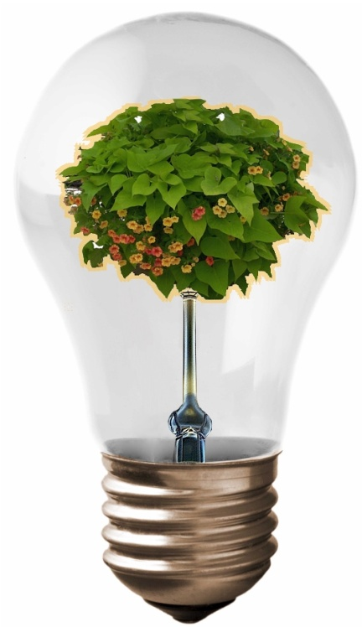
Environmental Sustainability Initiatives
Conservation of Electricity
A target of 4% reduction in monthly energy consumption has been achieved through the installation of energy saving lighting in Liquids and Solids packing areas, and installation of lighting-off motion detectors across Port Elizabeth Administration Office Sites
East London has achieved a 1% reduction in electricity consumption through installation of energy saving lights in the warehouses
A feasibility study is in progress to evaluate the possibilities of generating and making use of alternative renewable energy sources

Slide 31
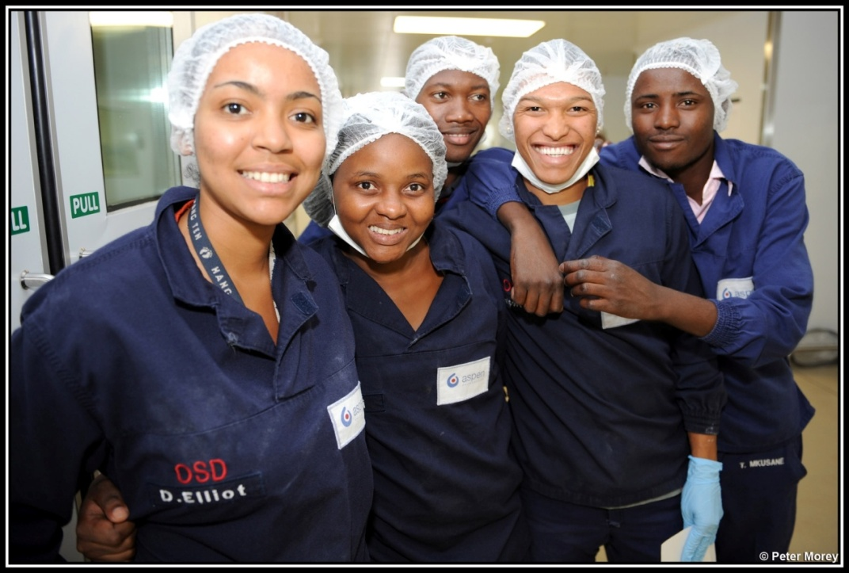
Social Sustainability Initiatives
We have secured job security for our permanent employees despite recessionary pressures facing manufacturers in South Africa
No permanent employees were made redundant by the implemented
continuous improvement initiatives
The Disabling Frequency Ratio of 0.63 against a tolerance of
1.00 demonstrates the effectiveness of safety standards at the facility
More than 950 employees participated in the 2010 voluntary HIV/AIDS testing and counselling programme
5% were HIV positive and are receiving the necessary treatment and support
In addition to extensive on-the-job procedural and technical training
that all staff receive in all aspects of operation, including GMP, SOPs
and equipment operation, more than 10% of all Operations
employees received external, specialised skills training in the
six months to December 2010

Slide 32
Risks and Challenges
Realisation of awarded public sector volumes
Mitigation: International volumes are being introduced to Port Elizabeth
Impact of inflation and currency movements on cost of goods
Mitigation: Benefits from continuous improvement initiatives and effective procurement strategies are being realised
Shortage of scarce skills – pharmacists and artisan
Mitigation: Pharmacists retention programmes are in place, and investment is made in learnership programmes for assistance pharmacists and apprenticeships for artisans
Increased competition from foreign suppliers
Mitigation:
Cost of goods are benchmarked against international prices
Aspen’s successful performance in the recent ARV tender demonstrates competitiveness
Aspen has proven to be a reliable supplier
Significant investment has been made in creating flexible and diverse manufacturing capability to respond to current and future requirements

Slide 33
Generics Bulletin Report : May 2010
Aspen incl Sigma (17,18, 19)
33

